Slide 1

Programming Project 1
Patient Data Protection
Jasmine Roberts
Dr.Haydar
September 8, 2024

Slide 2
Introduction
Developed a model to simulate IoT devices
Simulates the transmission of a secure health care data system
Meant to provide safe cnryption to secure data

Slide 3

Breaking down the given code vs. revised code

Slide 4

Starter Code (Given Code)

Slide 5
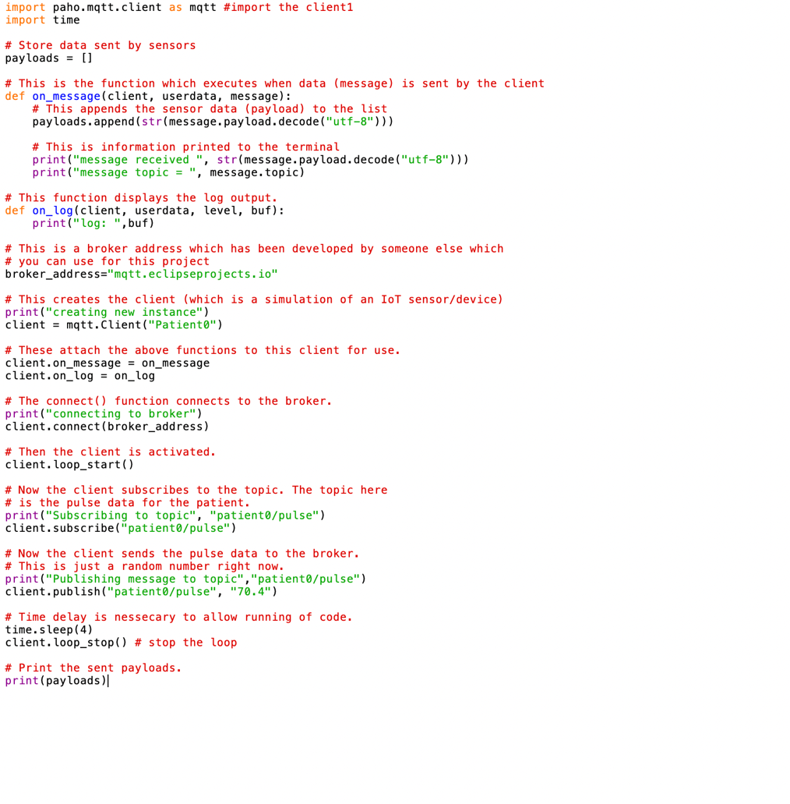
Given Code
Creates a simulated IoT Sensor
Connects the client to the broker
Subscribes the client to blood pressure data
Publishes Random BP data
Only had time and paho libariies
No encryption/dcryption function

Slide 6

Revised Code

Slide 7
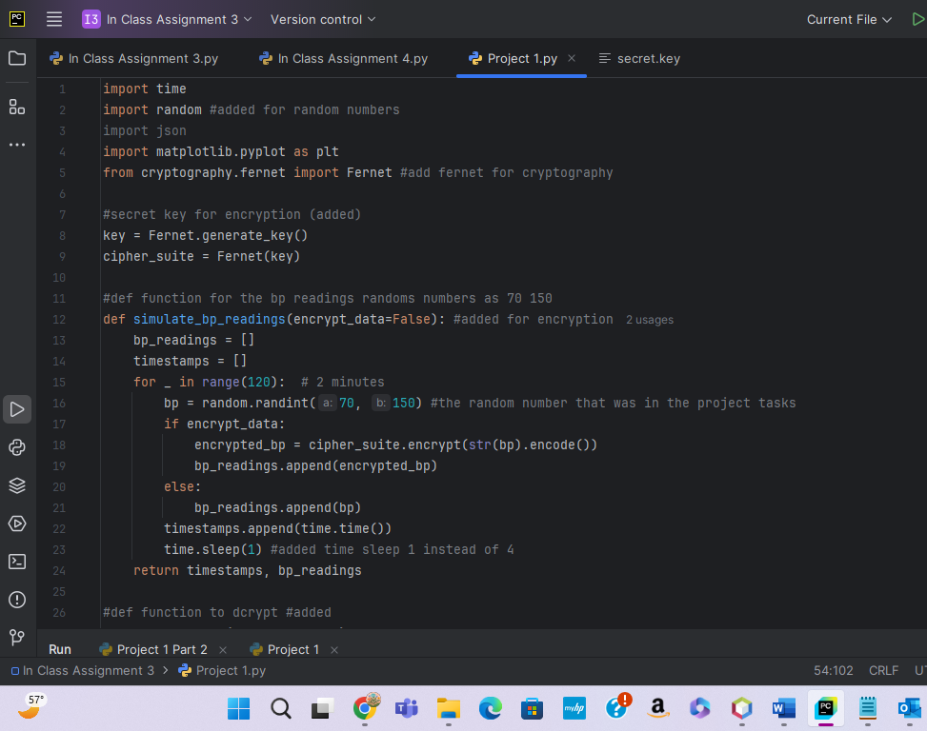
Revised Code
The python Libaries that were installed:
Fernet
Cryptogrpahy
Phao-mqtt
Message
Json
Random
Matplotlib
Given code only had time and paho and time
def on_message function would give me most of the error, expressing that “Client wasn’t a factor or defined” and “on message” wasn’t defined, pycharm instructed me to change the entire function.
That’s where I constructed:
def simulate_bp_readings which does equal the same things a def on_message because they are both functions to read data.
the function for encryption, ( encrypt_data=False)
bp = random .randint(70, 150)
The broker address kept sending back an error.

Slide 8
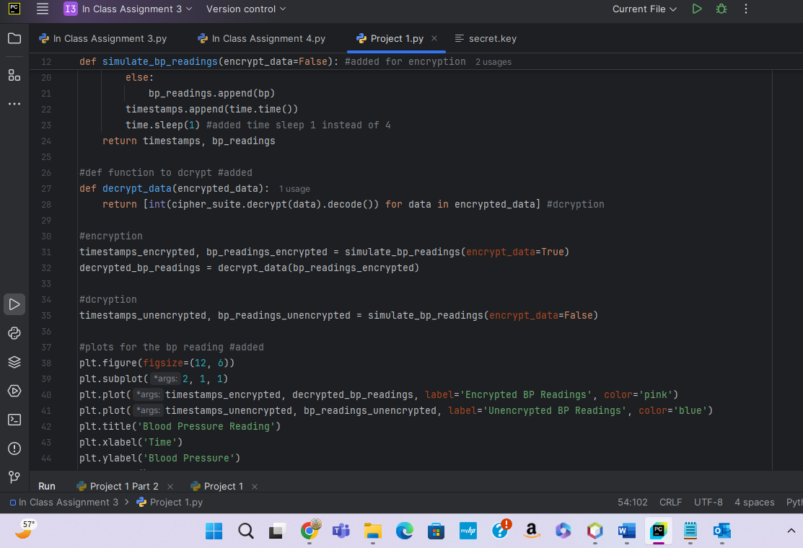
Revised Code Continued
I constructed the def simulate and def bp readings to receive data and analzyze it, and to put it in a log
Def on_message and Def bp readings are similar because they both read the bp data
Starter code did not have any encryption functions inside of it so I constucted:
- “def_dcrypt_data” , - “time_stamps”
Starter code did not have a secret key generator function, we needed this function in order for the code to be “encrypted”:
- #secret key for encryption (added) key = Fernet.generate_key() cipher_suite = Fernet(key)

Slide 9

Code Plots

Slide 10
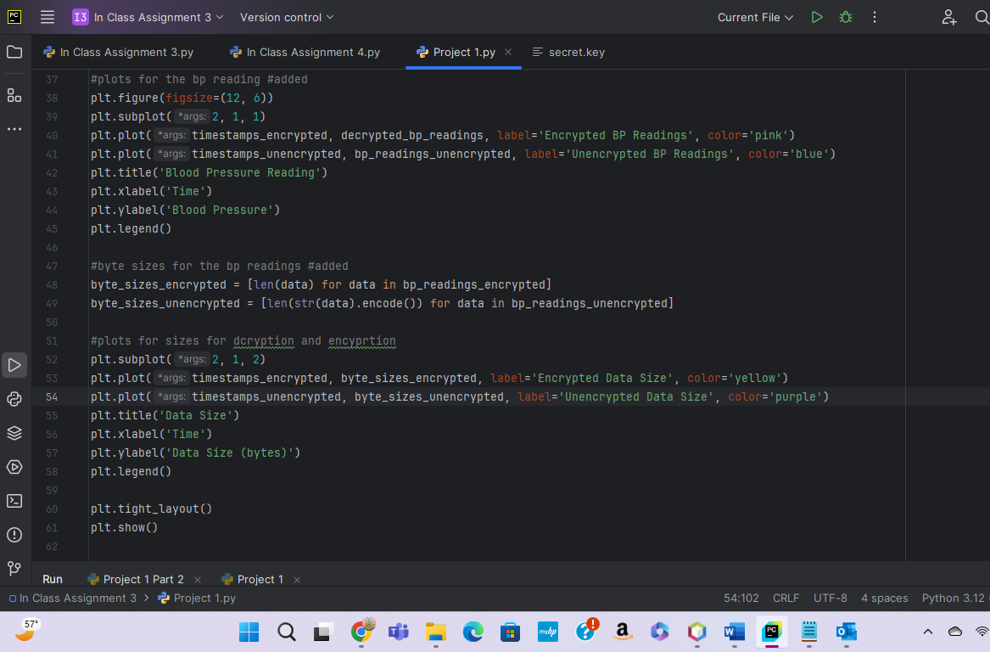
Revised Code
Plots Part 1:
Plots were constructed for the:
Color
Text Size
Labels
Encryoted Data Size
Unencrypted Data Size
Time
Date Size

Slide 11
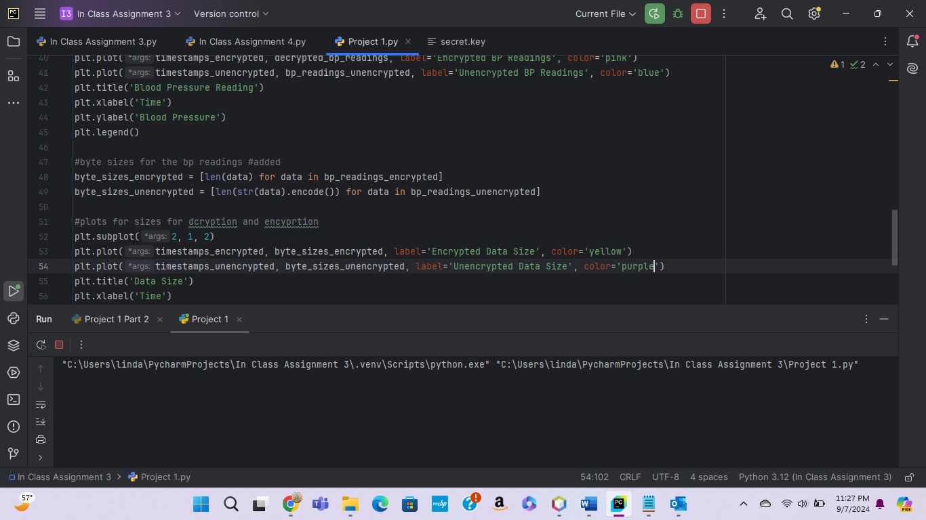
Revised Code
Plots Part 2:
Plots were constructed for the:
Color
Text Size
Labels
Encryoted Data Size
Unencrypted Data Size
Time
Date Size

Slide 12

Results

Slide 13
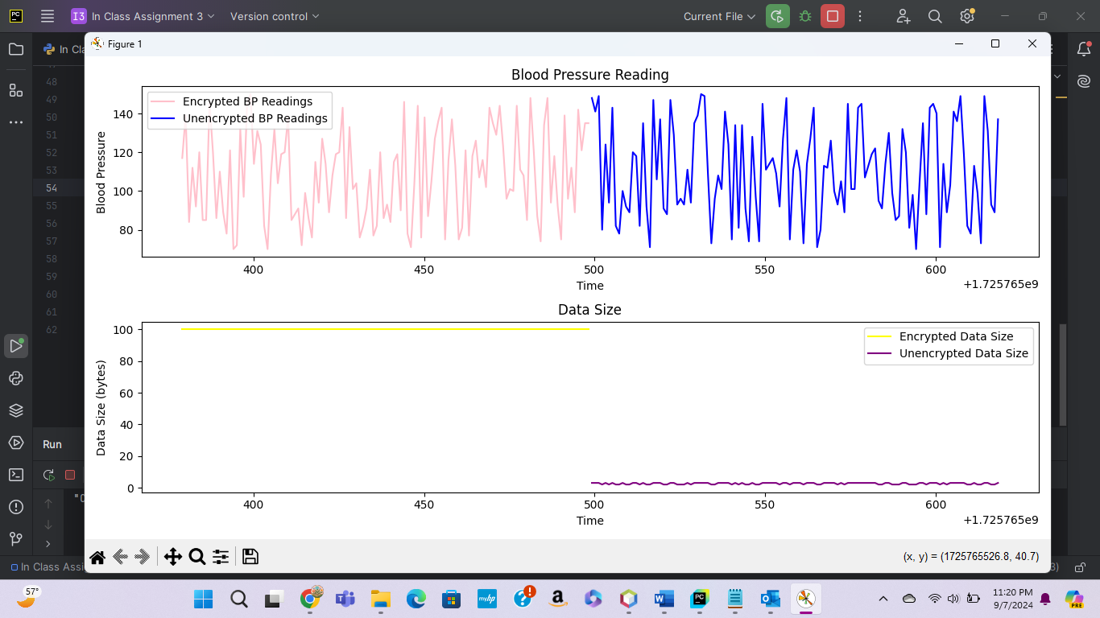
Results
Above is the results of the cosntructed code, a figure of the simulates health data simulator is created

Slide 14

How can the code be more realistic?
By:
Implementing real life blood pressure readings
Implementing real life pulse readings
Implementing more personal information about the patient

Slide 15
THE END

